Slide 1

A Comprehensive Analysis of Spag- get-tea Restaurant
Notes:
NOTE:
To change the image on this , select the picture and delete it. Then click the Pictures icon in the placeholder to insert your own image.

Slide 2
Table of Contents
1: Introduction
2: Lunch vs. Dinner Services
3: Imapct of Extending Lunch Specials
4: Financial Impact of Discontinuing Social Media Advertising
5: Most Profitable Menu Item
6: Raw Ingredients and Spoilage
7: Happy Path Ordering Process
8: Improvements to Ordering Process
9: Special of the Week
10: Conclusion

Slide 3
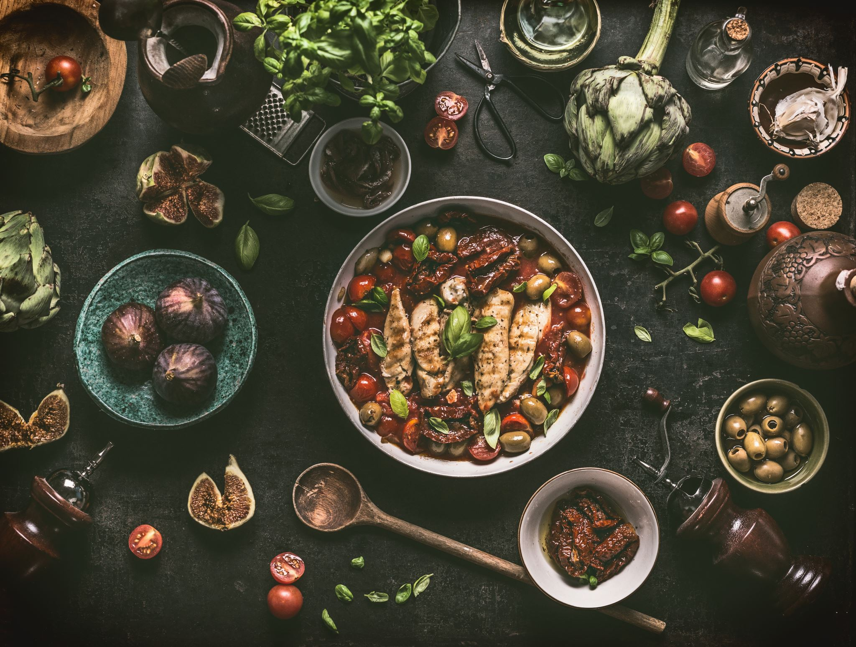
Introduction
Spag-Get-Tea, a beloved Italian restaurant, serves up delectable dishes crafted with care. Behind the scenes is Charlie, the visionary owner, constantly striving to improve and evolve the dining experience With a sharp focus on data, Charlie is investigating the dynamics of our business, from identifying popular menu items to understanding sales peaks during lunch versus dinner. His curiosity extends to comprehending the potential impact of changes—such as extending lunch hours until 4 pm and introducing a 25% discount on specials. As we delve into our findings derived from the provided data, we invite you to explore with us in the upcoming slides.

Slide 4
Lunch vs. Dinner Services
Class | Lunch (11 a.m. to 2 p.m.) | Dinner (Dinner 2 p.m. to 11 p.m.)
1. Number of Orders: | 548 orders | 1632 orders
2. Profitability: | $ 2,258.36 | $ 10,810
3. Average Spend per Order | $ 10.30 | $ 13.40
4. Most Ordered Dishes: | Bacon Butty: 55 orders Bangers & Mash: 34 orders Carbonara: 15 orders | Cottage Pie: 150 orders Bacon Butty: 76 orders Ravioli: 113 orders
5. Sales Differences: | $ 5,649 | $ 21,915
6. Profitable Dish Differences: | Bacon Butty ($470.25) | Cottage Pie ($1,687.5)

Slide 5
Impact of Extending Lunch Time 2 to 4
Overall, Loss in Sale
Extending lunchtime from 2 PM to 4 PM resulted in a significant sales decline of $1,110.5 units, suggesting it may not be a preferable strategy.

Slide 6
Financial Impact of Discontinuing Social Media Advertising

Slide 7

The analysis suggests that social media spending might play a crucial role in generating revenue and maintaining profitability, and a well-thought-out marketing strategy could be essential for sustained success.
Conclusion:
The restaurant made more profits in week 1 ($6,423.90) than in week 2 ($4,604.55), even after considering the amount spent on social media.
Dropping the social media spending to zero in week 2 did not result in saving money; instead, it contributed to a lower overall profit.
This Photo by Unknown Author is licensed under CC BY

Slide 8

Most Profitable Menu Item
Cottage Pie

Slide 9
Raw Ingredients and Spoilage
Item | Shelf Life | Sold by Weight | Weekly Usage per week 1 data(In KG) | Weekly Usage per week 2 data(In KG) | Order Quantity per batch per Weekly Usage per week 1 data | Order Quantity per batch per Weekly Usage per week 2 data | Average | Backup per forcasting (10%) | Net Week Order
Spaghetti | Nonexpired | 100 | 38.0 | 23.5 | 380.0 | 235.0 | 307.5 | 31 | 338
Rice | Nonexpired | 50g | 13.4 | 10.4 | 268.0 | 208.0 | 238.0 | 24 | 262
Arborio Rice | Nonexpired | 50g | 31.5 | 15.6 | 630.0 | 312.0 | 471.0 | 47 | 518
Pasta | 1 weeks | 100g | 30.8 | 13.6 | 308.0 | 136.0 | 222.0 | 22 | 244
Puff pastry | 1 weeks | 100g | 7.4 | 5.5 | 74.0 | 55.0 | 64.5 | 6 | 71
Flour | 4 weeks | 200g | 50.4 | 38.4 | 252.0 | 192.0 | 222.0 | 22 | 244
Beef | Freeze for 2 weeks | 100g | 42.2 | 26.9 | 422.0 | 269.0 | 345.5 | 35 | 380
Chicken | Freeze for 2 weeks | 100g | 41.1 | 31.2 | 411.0 | 312.0 | 361.5 | 36 | 398
Fish | Freeze for 2 weeks | 100g | 25.2 | 18.9 | 380.0 | 189.0 | 284.5 | 28 | 313
Item | Shelf Life | Sold by Liters | Weekly Usage per week 1 data(In Liters) | Weekly Usage per week 2 data(In Liters) | Order Quantity per batch per Weekly Usage per week 1 data | Order Quantity per batch per Weekly Usage per week 2 data | Average | Backup per forcasting (10%) | Net Week Order
Cream | Freeze for 2 weeks | 100ml | 7.7 | 3.4 | 77.0 | 34.0 | 55.5 | 6 | 61
Item | Shelf Life | Sold by Batch in quantity | Weekly Usage per week 1 data(In Batch ) | Weekly Usage per week 2 data(In Batch) | Order Quantity per batch per Weekly Usage per week 1 data | Order Quantity per batch per Weekly Usage per week 2 data | Average | Backup per forcasting (10%) | Net Week Order
Eggs | Freeze for 2 weeks | 12.00 | 336.0 | 256.0 | 28.0 | 21.3 | 24.7 | 2 | 27
Parmesan Cheese | 6 Month | 100.00 | 27.0 | 20.8 | 269.5 | 208.0 | 238.8 | 24 | 263
Bacon | Freeze for 2 weeks | 12.00 | 658.0 | 436.0 | 54.8 | 36.3 | 45.6 | 5 | 50
Sausages | Freeze for 2 weeks | 6.00 | 420.0 | 305.0 | 70.0 | 50.8 | 60.4 | 6 | 66
Bap | 1 weeks | 13.00 | 70.0 | 60.0 | 5.4 | 4.6 | 5.0 | 1 | 6
Mushrooms | 2 weeks | 25 | 1056.0 | 690.0 | 42.2 | 27.6 | 34.9 | 3 | 38
Potatoes | 3 weeks | 12.00 | 1680.0 | 1240.0 | 140.0 | 103.3 | 121.7 | 12 | 134
Tomatoes | 1 weeks | 12.00 | 1420.0 | 997.0 | 118.3 | 83.1 | 100.7 | 10 | 111
Avocado | Freeze for 2 weeks | 1 | 74.0 | 55.0 | 74.0 | 55.0 | 64.5 | 6 | 71
Onion | 2 weeks | 8.00 | 148.0 | 110.0 | 18.5 | 13.8 | 16.1 | 2 | 18

Slide 10
Assumptions:
Assumptions:
Calculations are based on Weekly order frequency.
Consistent demand based on the observed period.
Shelf-life considerations for each ingredient.
A buffer of 10% for each ingredient to account for variability.
Notes:
The "Average Weekly Usage" is calculated by taking the average of the weekly usage for the observed weeks.
The "Order Quantity" is then determined by adding a buffer of 10% to the average weekly usage.

Slide 11
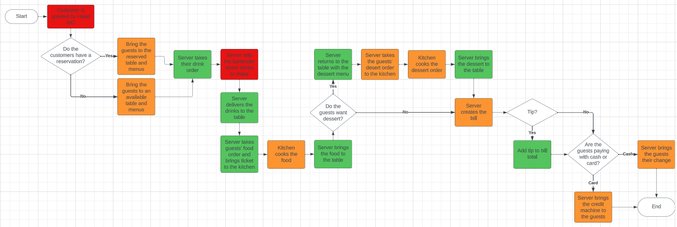
Happy Path of Ordering Process

Slide 12
Ordering Process Improvements:
The reservation process can be updated by requiring the customer to provide a phone number, so the restaurant has a way to contact them. If the customer is 15 minutes late the restaurant can call to see if the customer is still coming, if they don’t respond their table will be forfeited. This will reduce the wait time for the other customers when it is busy.
The restaurant should have an updated POS system that can allow the server to print a ticket for the kitchen and provide a description of each menu item. This will reduce errors and prevent time waste.

Slide 13
Special of the Week: Bacon Butty
Selecting 'Bacon Butty' as the special of the week, despite a 25% discount, guarantees a strong profit margin preservation of 81% during lunch and 86% during dinner.

Slide 14
Reasons for choosing Bacon Butty
1. High-Profit Margin: Even with a 25% discount, 'Bacon Butty' maintains an impressive profit margin, preserving 81% during lunch and 86% during dinner. This ensures the promotional offer remains financially advantageous for the restaurant.
2. Customer Appeal: 'Bacon Butty' is not only popular but also well-liked by customers. Its combination of high-profit margin and popularity enhances the potential for increased sales during the promotional period.
3. Cost-Effectiveness: 'Bacon Butty' stands out as a cost-effective choice compared to other menu items. Selecting it as the special of the week ensures optimal financial returns for Spag-Get-Tea.
4. Optimizing Demand: With a demand of only 130, featuring 'Bacon Butty as the special of the week presents an opportunity to capitalize on its popularity and drive higher sales, effectively maximizing revenue during the promotional period.

Slide 15
Conclusion
As Charlie continues to enhance the Spag-Get-Tea Italian restaurant's operations, these findings and recommendations serve as a foundation for informed decision-making, ensuring sustained success and an enhanced dining experience for customers.

Slide 16

Thank you

